Slide 1
OVERVIEW OF PROSPECTIVE TEACHER STUDENTS' METASYSTEMATIC REASONING IN INVERTEBRATE ZOOLOGY PRACTICUM
Dr. Aa Juhanda, M.Pd.
Gina Nuranti, S.Pd., M.Si
THE 1ST INTERNATIONAL CONFERENCE ON MULTIDISIPLINARY STUDIES 2024
Universitas Muhammadiyah Sukabumi, Indonesia – 7th August 2024

Slide 2
INTRODUCTION

Slide 3
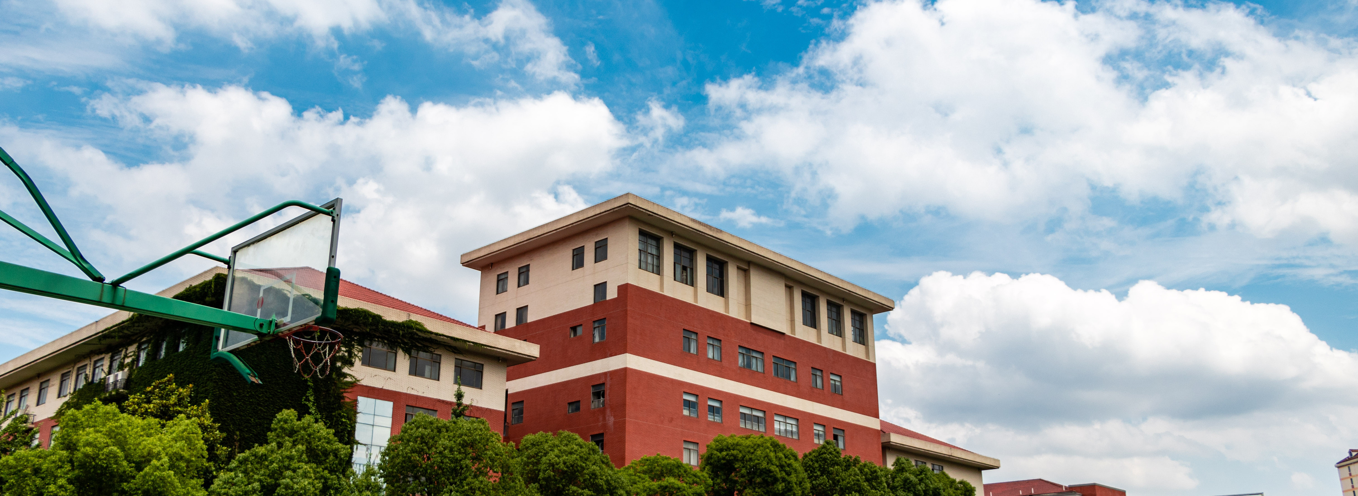
METHODOLOGY
Methods
Samples
Instruments
This study used a descriptive qualitative method to describe the metasystematic reasoning of prospective teacher students in the context of invertebrate zoology practicum.
30 prospective teacher students in semester 4 who were participating in the practicum of invertebrate zoology who were selected purposively in the Biology Education Study Program at Universitas Muhammadiyah Sukabumi.
8 validated metasystematic reasoning questions
observation sheets
lecturer interview formats
student questionnaires.
: using the percentage technique method and interpreted based on Arikunto (2012)
Data analysis

Slide 4
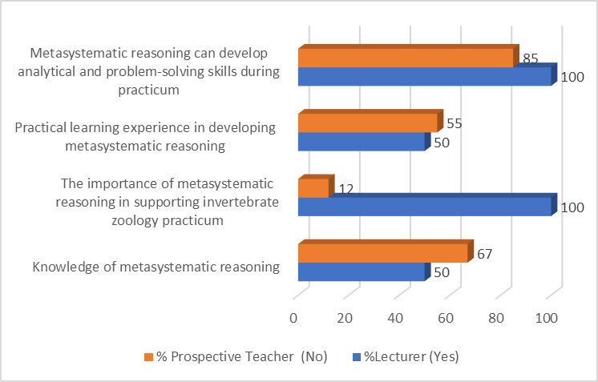
RESULTS AND DISCUSSION
FINDINGS
Almost half of the lecturers and students were aware of metasystematic reasoning and had done it in practicum learning. There are differences in views between lecturers and students regarding the application of metasystematic reasoning in practicum learning of invertebrate zoology. This is in line with the findings of a recent study that students often feel less confident in applying advanced reasoning, even though they recognize the importance of this skill in their academic development.
Figure 1. Lecturer and Prospective Teacher Students Responses related to Metasystematic Reasoning in Invertebrate Zoology Practicum

Slide 5
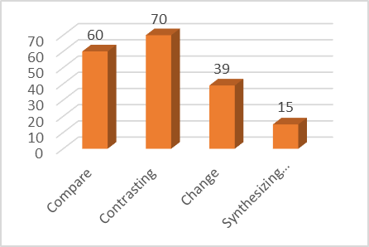
DISCUSSION
FINDINGS
Based on the test results using metasystematic reasoning questions, it was found that the average achievement of students' metasystematic reasoning was 46%. This shows that students lack metasystematic reasoning about invertebrate zoological concepts. They often face difficulties in integrating theoretical knowledge with field practice effectively.
Figure 2. Percentage of Metasystematic Reasoning Indicators of Prospective Teacher Students in Invertebrate Zoology Practicum

Slide 6
CONCLUSION
Metasystematic reasoning of prospective teacher students in invertebrate zoology practicum is still in the less category, which is 46%.
Prospective teacher students have metasystematic reasoning with the highest percentage of achievement in the contrasting indicator and the lowest in the system synthesizing indicator.
Prospective teacher students and lecturers responded positively that metasystematic reasoning is important in the practicum of invertebrate zoology.
Lecturers need to develop problem-based learning approaches and interdisciplinary learning in designing and managing practicum that can help train prospective teachers' metasystematic reasoning.

Slide 7
ACKNOWLEDGEMENTS
Thanks to LPPM Universitas Muhammadiyah Sukabumi for the material support in the implementation of this Community Service activity.

Slide 8
THANK YOU

