Slide 1
Global Burden of Disease: HIV
Prof. Dr Syed Amir Gilani
MBBS, DMRD, MPH
PhD (Public Health) PhD (Ultrasound)
Rector; The University of Faisalabad.
Rector; Green International University ,
Lahore,Pakistan.

Slide 2
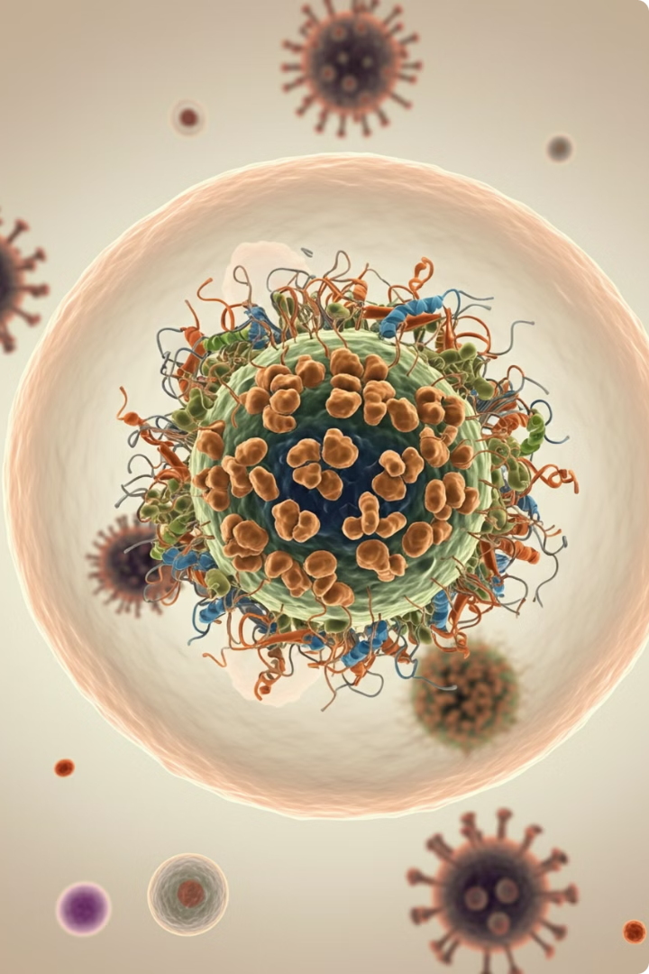
Introduction to HIV/AIDS
1
Human Immunodeficiency Virus (HIV)
HIV is a retrovirus that infects and weakens the immune system, making individuals susceptible to opportunistic infections and diseases.
2
Acquired Immunodeficiency Syndrome (AIDS)
AIDS is the most advanced stage of HIV infection, characterized by severe immune deficiency and a high risk of life-threatening illnesses.
3
Global Health Crisis
HIV/AIDS has had a profound impact on global health, leading to millions of deaths and affecting millions more.

Slide 3
Epidemiology of HIV/AIDS
Global Distribution
HIV is prevalent in many regions, with sub-Saharan Africa
experiencing the highest burden.
Transmission Patterns
HIV transmission varies geographically, influenced by factors like sexual behavior, injection drug use, and access to healthcare.
Population Groups
Certain population groups, including men who have sex with men, sex workers, and people who inject drugs, are disproportionately affected by HIV.
Changing Trends
Over time, HIV epidemiology has shifted due to advancements in treatment, prevention strategies, and changing social norms.

Slide 4
Modes of HIV Transmission
Sexual Contact
1
HIV is primarily transmitted through unprotected sexual contact.
Blood-to-Blood
2
Sharing needles, blood transfusions, or other blood-related exposures can lead to HIV transmission.
Mother-to-Child
3
HIV can be transmitted from an infected mother to her child during pregnancy, labor, delivery, or breastfeeding.
Understanding the modes of HIV transmission is crucial for prevention efforts
Notes:
. Individuals should be aware of the risks associated with unprotected sex, sharing needles, and blood-related exposures. Prevention strategies, such as condom use, needle exchange programs, and antiretroviral therapy, can significantly reduce the risk of transmission.

Slide 5
Risk Factors for HIV Infection
1
Unprotected Sexual Contact
Lack of condom use increases vulnerability.
2
Injection Drug Use
Sharing needles spreads the virus.
Mother-to-Child Transmission
3
HIV can pass from mother to child during pregnancy, labor, delivery, or breastfeeding.
4
Blood Transfusions
Unsafe blood transfusions can transmit HIV.
Notes:
These include engaging in unprotected sexual activity, sharing needles for injecting drugs, receiving unsafe blood transfusions, and exposure to infected bodily fluids.
Understanding these risk factors is crucial for promoting safer sexual practices, preventing needle sharing, and ensuring safe blood transfusions. Access to comprehensive HIV prevention services and education plays a vital role in reducing the risk of HIV infection.

Slide 6
Pathogenesis of HIV Infection
Viral Entry
HIV enters the body through mucosal
surfaces or the bloodstream.
Immune System Targeting
HIV primarily targets CD4+ T cells, a critical
component of the immune system.
Viral Replication
HIV integrates its genetic material into the host cell's DNA,
leading to viral replication.
Immune System Decline
Over time, HIV destroys CD4+ T cells, weakening the immune system.
Opportunistic Infections
With a compromised immune system, individuals become
susceptible to opportunistic infections and diseases.

Slide 7
Clinical Stages of HIV Infection
Stage 1: Acute HIV Infection
1
Initial infection, flu-like symptoms.
Stage 2: Clinical Latency
2
HIV is present but dormant, immune system is weakened.
Stage 3: AIDS
3
Severe immune deficiency, opportunistic infections.
HIV infection progresses through distinct stages, each characterized by specific clinical features and immune system status.
Notes:
The acute stage involves a sudden and temporary flu-like illness. This is followed by clinical latency, a period where the virus is present but dormant. If untreated, the infection progresses to AIDS, characterized by severe immune deficiency and a high risk of life-threatening illnesses.

Slide 8
Articles on HIV co-authored by
Prof. Dr. Syed Amir Gilani
Global, regional, and national sex-specific burden and control of the HIV epidemic, 1990–2019, for 204 countries and territories: the Global Burden of Diseases Study 2019.
Available from: https://www.researchgate.net/publication/354876904_Global_regional_and_national_sex-specific_burden_and_control_of_the_HIV_epidemic_1990-2019_for_204_countries_and_territories_the_Global_Burden_of_Diseases_Study_2019 . Lancet HIV 2021; 8: e633–51
Mapping subnational HIV mortality in six Latin American countries with incomplete vital registration systems. Local Burden of Disease HIV Collaborators BMC Medicine (2021)19:4https://doi.org/10.1186/s12916-020-01876-4 , BMC Medicine 2121. Available from : https://www.researchgate.net/publication/348324718_Mapping_subnational_HIV_mortality_in_six_Latin_American_countries_with_incomplete_vital_registration_systems
Global age-sex-specific fertility, mortality, healthy life expectancy (HALE), and population estimates in 204 countries and territories, 1950–2019: a comprehensive demographic analysis for the Global Burden of Disease Study 2019.
Available from: https://www.researchgate.net/publication/366166999_Global_age-sex-specific_fertility_mortality_healthy_life_expectancy_HALE_and_population_estimates_in_204_countries_and_territories_1950-2019_a_comprehensive_demographic_analysis_for_the_Global_Burden_ . Lancet 2020; 396: 1160–203

Slide 9
Global Burden of Disease: HIV
HIV is a global health crisis, impacting
millions of people worldwide.
The World Health Organization (WHO) estimates that 39.0 million [33.1 million–45.7 million] people globally were living with HIV in 2022.

Slide 10
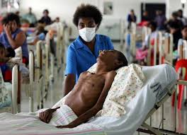
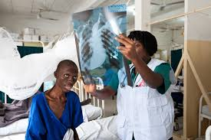
Global HIV & AIDS statistics: Fact sheet 2023
1.3 million [1 million–1.7 million] people became newly
infected with HIV in 2022.
630 000 [480 000–880 000] people died from
AIDS-related illnesses in 2022.
29.8 million people were accessing antiretroviral therapy
in 2022.
85.6 million [64.8 million–113.0 million] people have
become infected with HIV since the start of the epidemic.
40.4 million [32.9 million–51.3 million] people have died
from AIDS-related illnesses since the start of the epidemic.

Slide 11
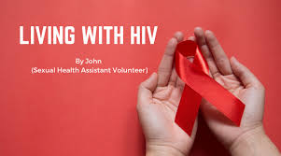
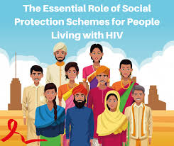
People living with HIV
In 2022, there were 39.0 million [33.1 million–45.7 million]
people living with HIV.
37.5 million [31.8 million–43.6 million] adults
(15 years or older).
1.5 million [1.2 million–2.1 million] children (0–14 years).
53% of all people living with HIV were women and girls.
86% [73– >98%] of all people living with HIV knew their
HIV status in 2022.
About 5.5 million people did not know that they were living
with HIV in 2022.

Slide 12
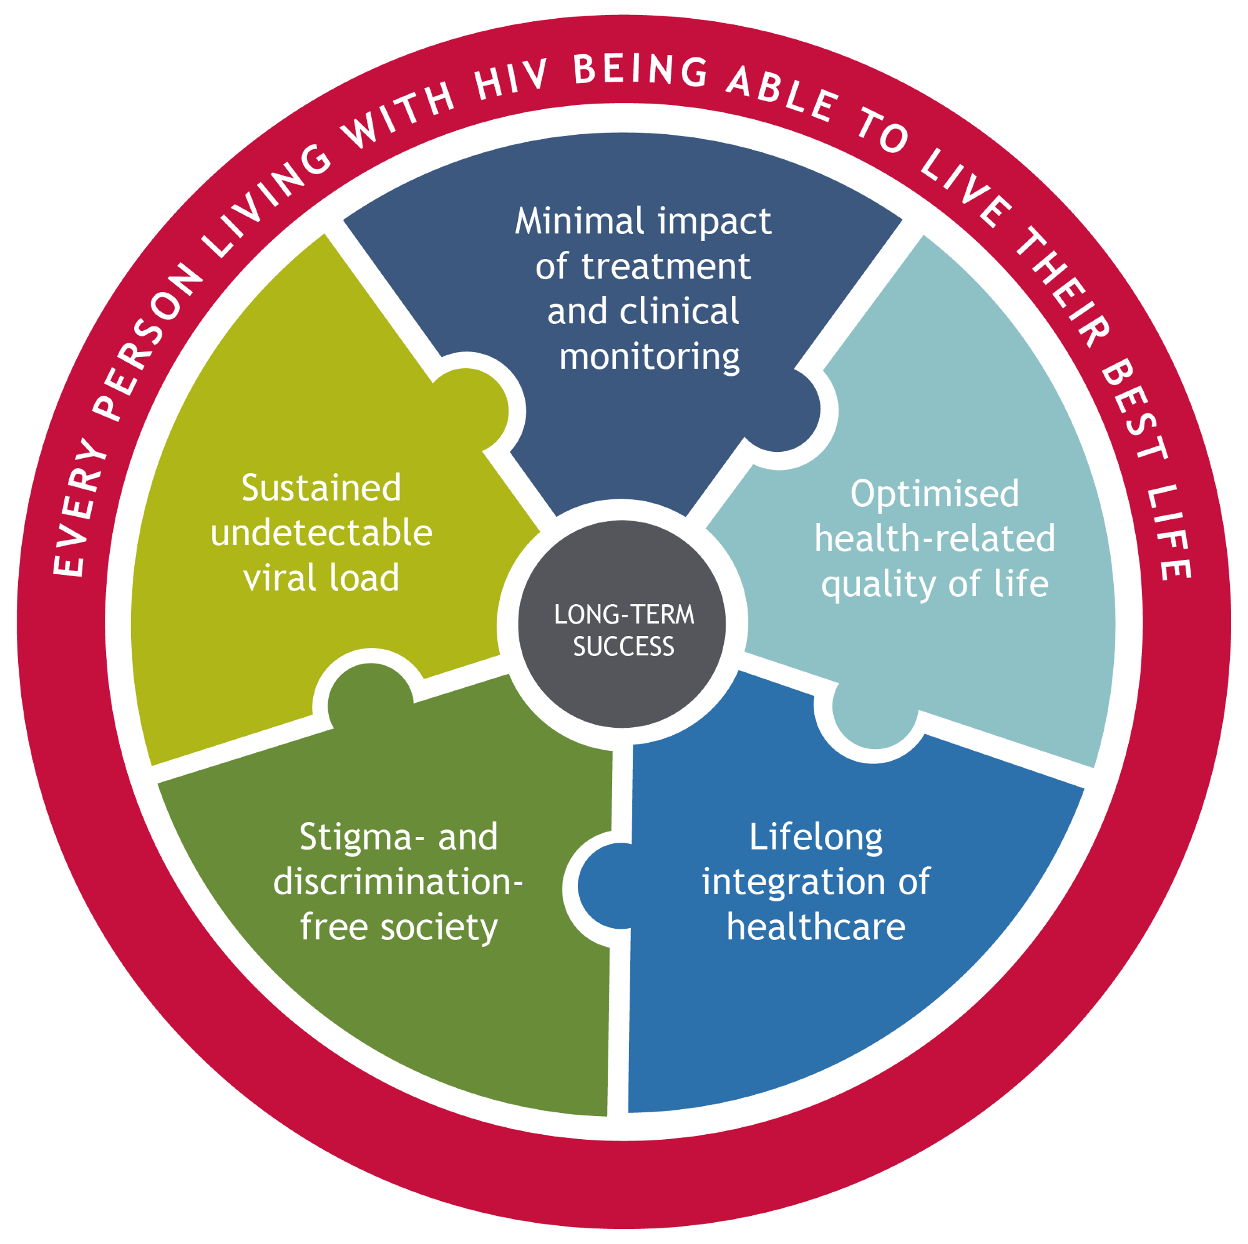
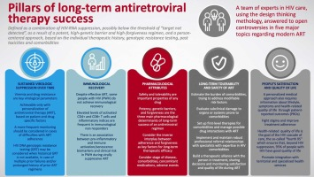
People living with HIV accessing antiretroviral therapy
At the end of December 2022, 29.8 million people were accessing antiretroviral therapy, up from 7.7 million in 2010.
In 2022, 76% [65–89%] of all people living with HIV were accessing treatment.
77% [65–90%] of adults aged 15 years and older living with HIV had access to treatment, as did 57% [44–78%] of children aged 0–14 years.
82% [69–95%] of women aged 15 years and older had access to treatment; however, just 72% [60–84%] of men aged 15 years and older had access.
82% [64–98%] of pregnant women living with HIV had access to antiretroviral medicines to prevent transmission of HIV to their child in 2022.

Slide 13
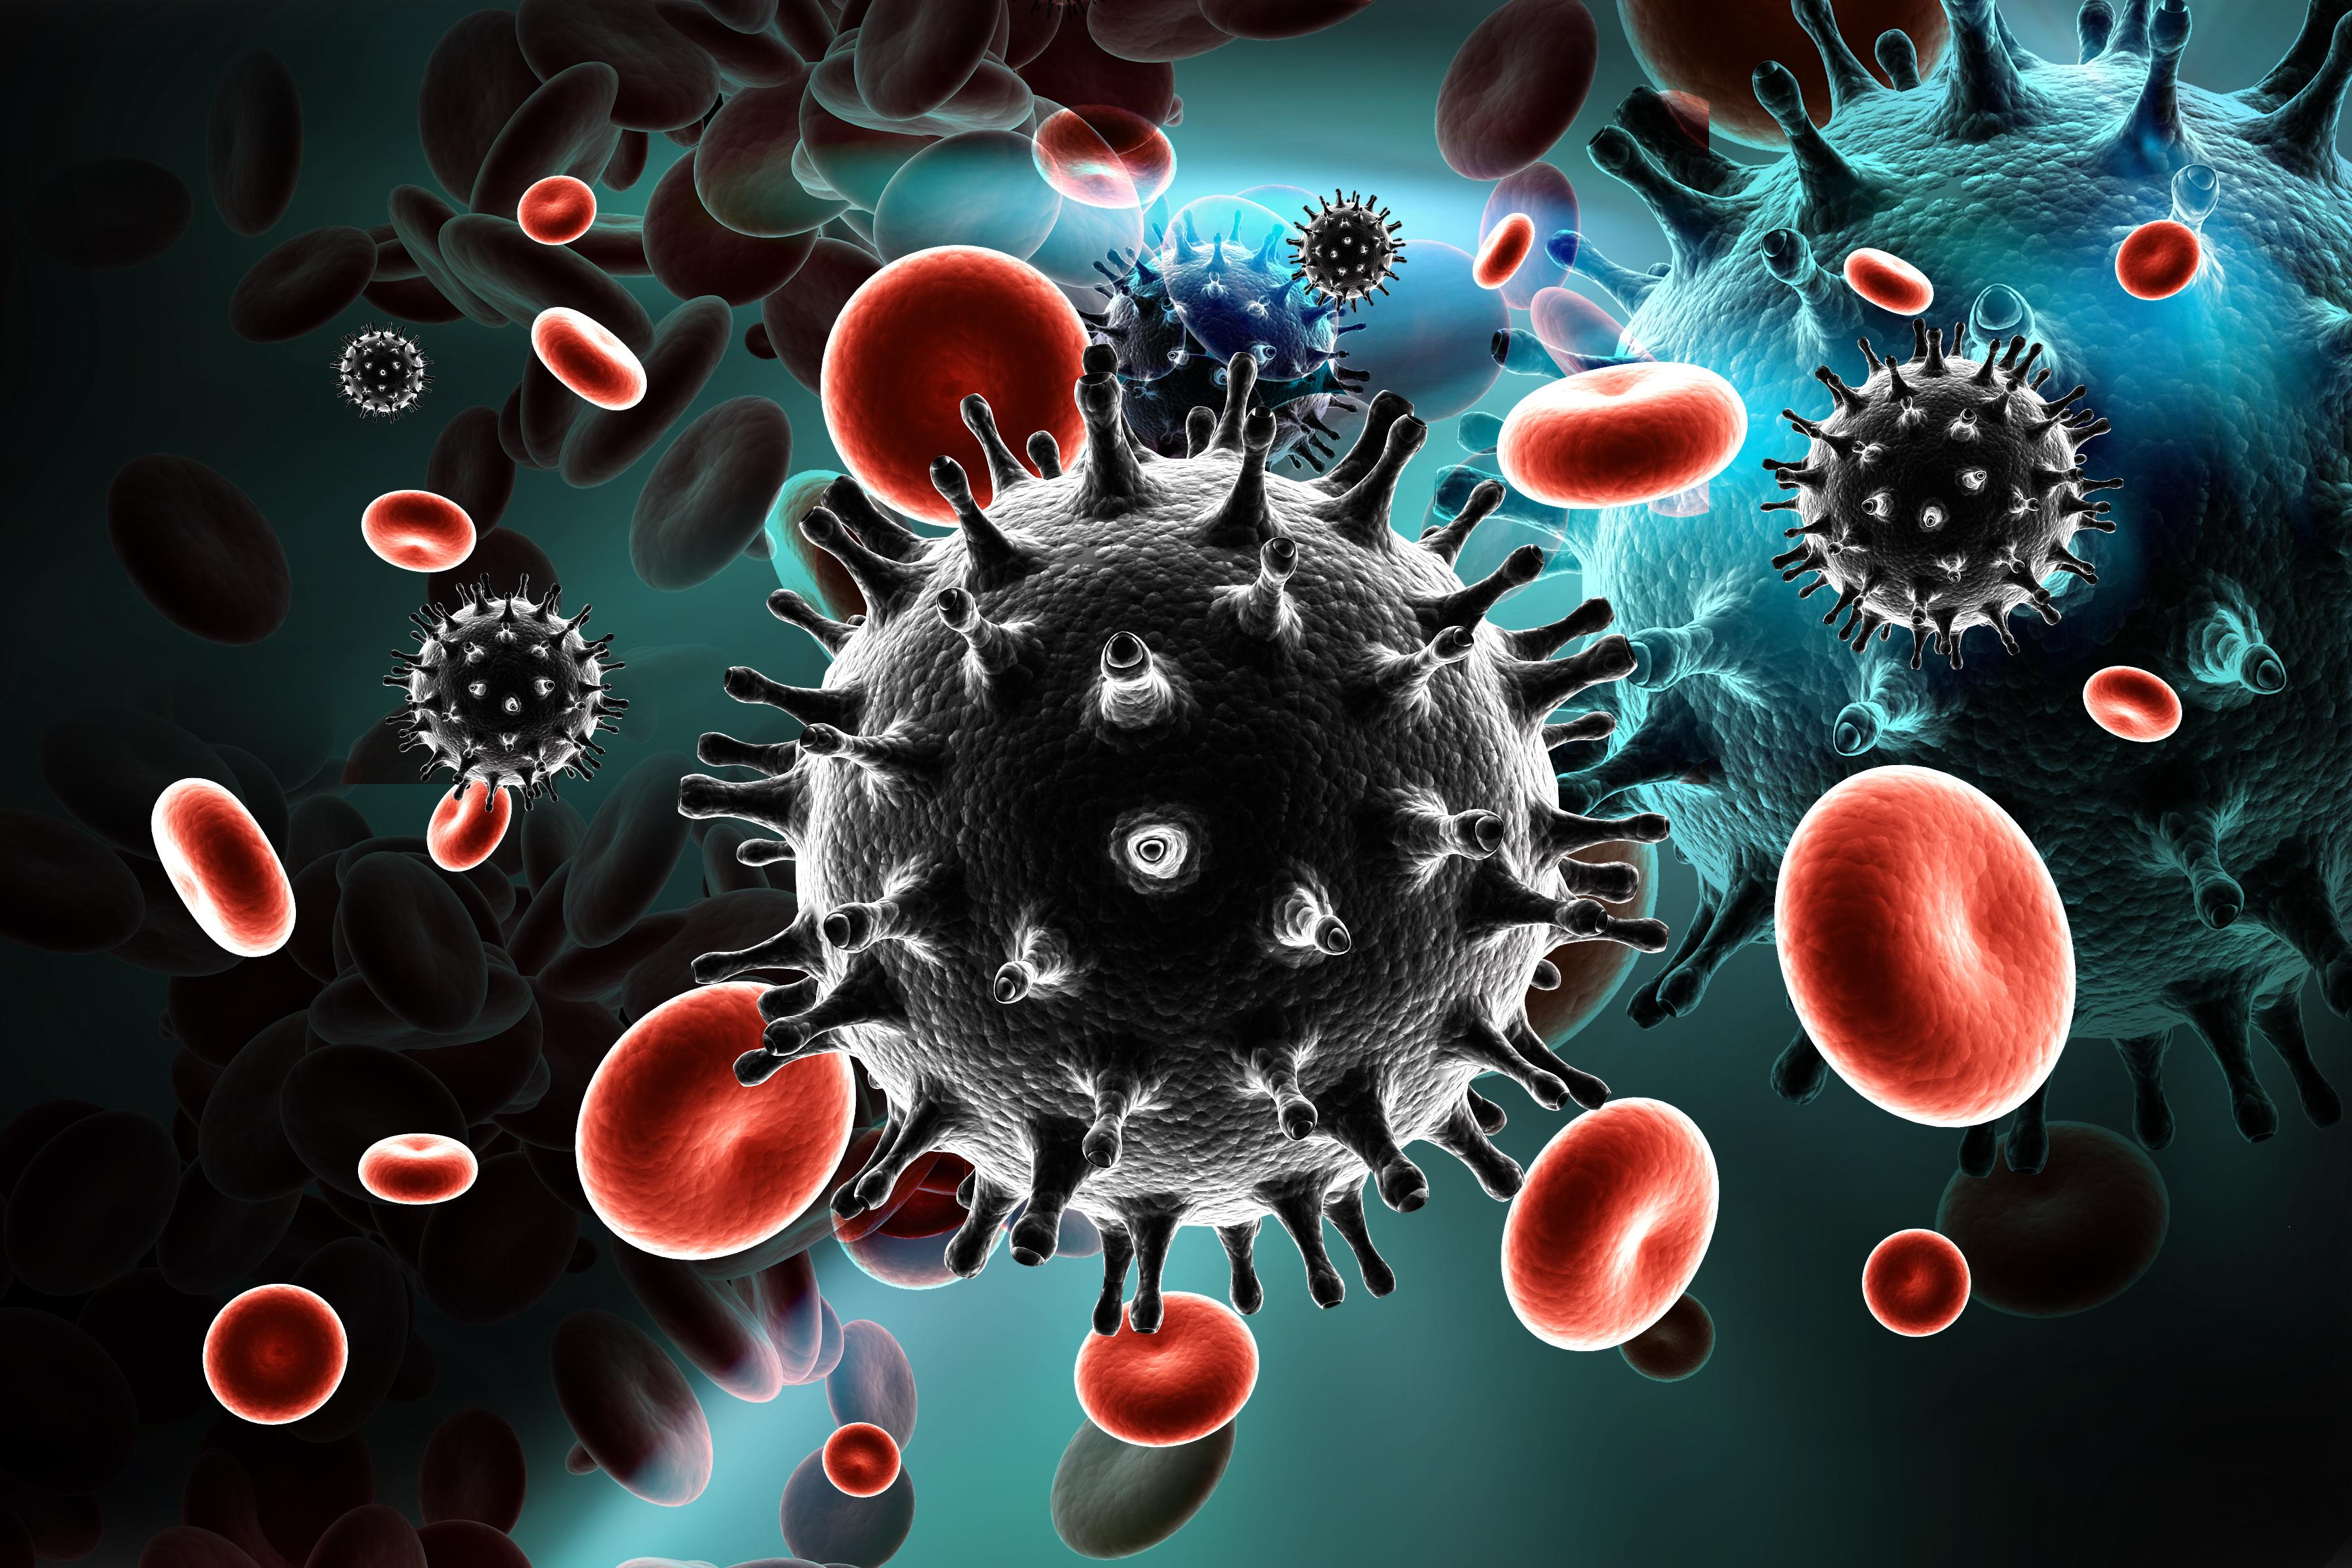
New HIV infections
New HIV infections have been reduced by 59% since the peak in 1995.
In 2022, 1.3 million [1 million–1.7 million] people were newly infected with HIV, compared to 3.2 million [2.5 million–4.3 million] people in 1995.
Women and girls accounted for 46% of all new infections in 2022.
Since 2010, new HIV infections have declined by 38%, from 2.1 million [1.6 million–2.8 million] to 1.3 million [1 million–1.7 million] in 2022.
Since 2010, new HIV infections among children have declined by 58%, from 310 000 [210 000–490 000] in 2010 to 130 000 [90 000–210 000] in 2022.

Slide 14
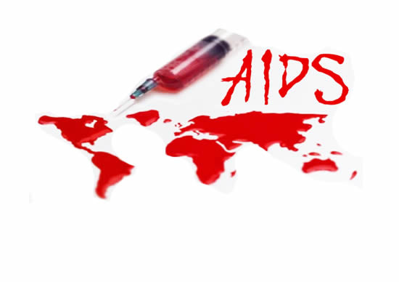
AIDS - Related Deaths
AIDS-related deaths have been reduced by 69% since the peak in 2004 and by 51% since 2010.
In 2022, around 630 000 [480 000–880 000] people died from AIDS-related illnesses worldwide, compared to 2.0 million [1.5 million–2.8 million] people in 2004 and 1.3 million [970 000–1.8 million] people in 2010.
AIDS-related mortality has declined by 55% among women and girls and by 47% among men and boys since 2010.

Slide 15
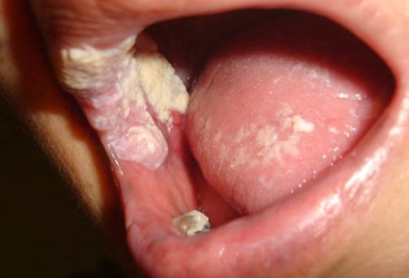
Key Populations
Globally, median HIV prevalence among the adult population (ages 15-49) was 0.7%. However median prevalence was higher among key populations
2.5% among sex workers
7.7% among gay men and other men who have sex with men
5.0% among people who inject drugs
10.3% among transgender persons
1.4% among people in prisons.

Slide 16
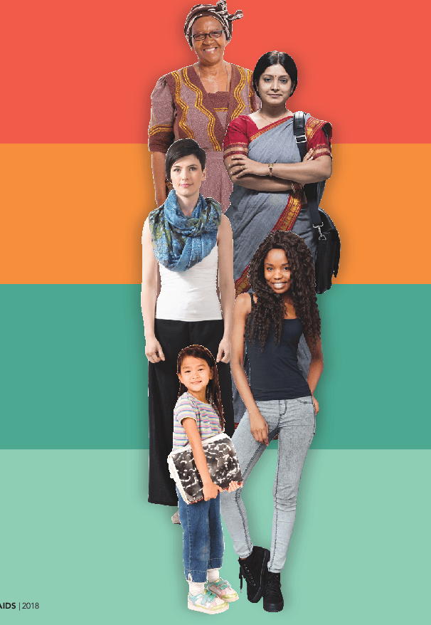
Women and Girls
Globally 46% of all new HIV infections were among women and girls (all ages) in 2022.
In sub-Saharan Africa, women and girls (all ages) accounted for 63% of all new HIV infections. In all other geographical regions, over 70% of new HIV infections in 2022 occurred among men and boys.
Every week, 4000 adolescent girls and young women aged 15–24 years became infected with HIV globally in 2022. 3100 of these infections occurred in sub-Saharan Africa.

Slide 17
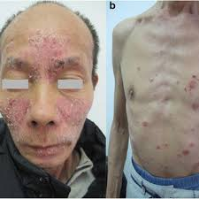
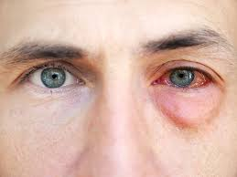
Investments
At the end of 2022, US$ 20.8 billion (in constant 2019 United States dollars) was available for the AIDS response in low- and middle-income countries—around 60% was from domestic sources.
UNAIDS estimates that US$ 29 billion (in constant 2019 United States dollars) will be required for the AIDS response in low- and middle-income countries, including countries formerly considered to be upper-income countries, in 2025 to get on track to end AIDS as a public health threat.

Slide 18
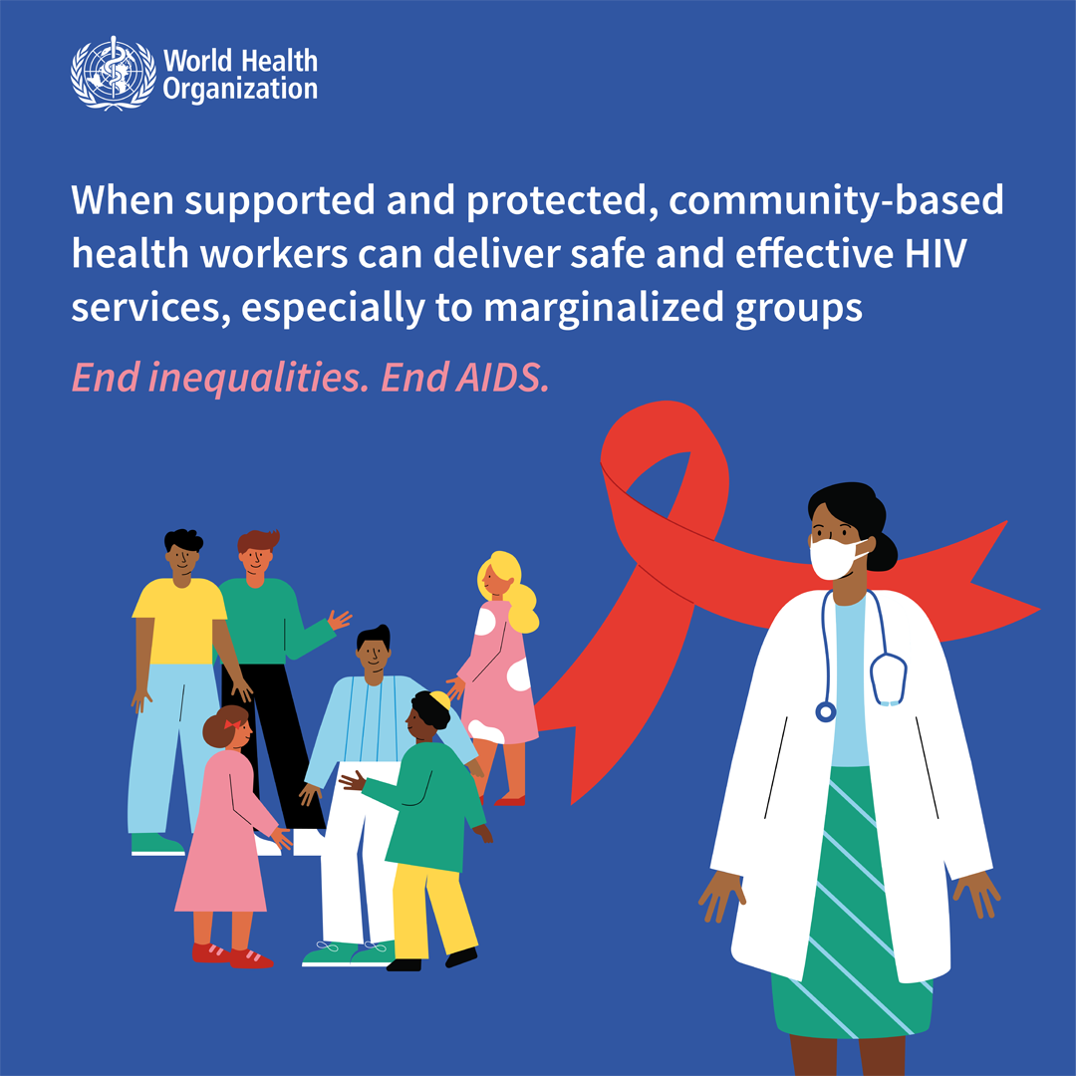
WHO Response
Global health sector strategies on, respectively, HIV, viral hepatitis, and sexually transmitted infections for the period 2022–2030 guide the health sector in implementing strategically focused responses to achieve the goals of ending AIDS, viral hepatitis B and C and sexually transmitted infections by 2030.
The GHSS recommend shared and disease-specific country actions supported by actions by WHO and partners.
They consider the epidemiological, technological, and contextual shifts of previous years, foster learnings across the disease areas, and create opportunities to leverage innovations and new knowledge for effective responses to the diseases.
Notes:
They call for a precise focus to reach the people most affected and at risk for each disease that addresses inequities. They promote synergies under a universal health coverage and primary health care framework and contribute to achieving the goals of the 2030 Agenda for Sustainable Development.

Slide 19
Diagnosis and Testing for HIV
1
Laboratory Testing
HIV testing involves detecting the presence of antibodies
or viral RNA in blood samples.
2
Types of Tests
Common tests include ELISA, Western blot, and rapid
antibody tests, which provide quick results.
3
Confirmatory Testing
Positive results from initial tests are confirmed with more specific tests, such as Western blot or viral load testing.
4
Counseling and Support
Pre- and post-test counseling is essential to provide information,
address concerns, and offer support.

Slide 20
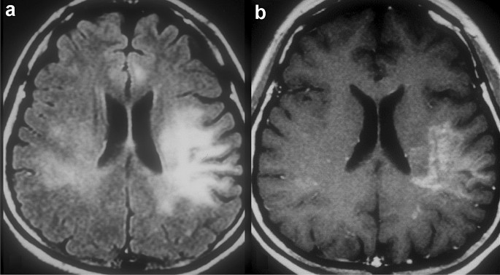
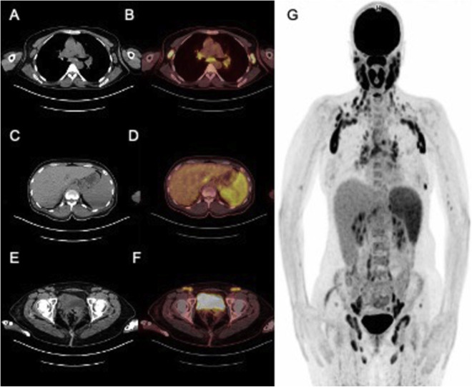
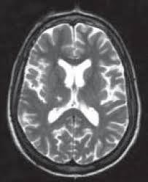
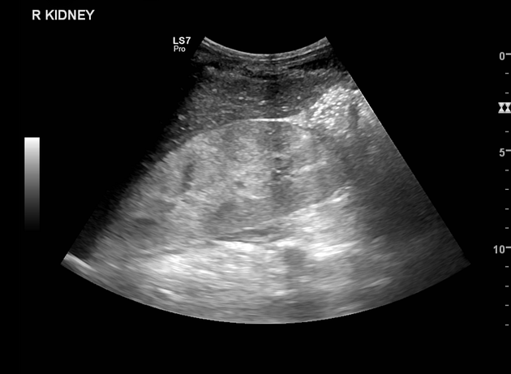
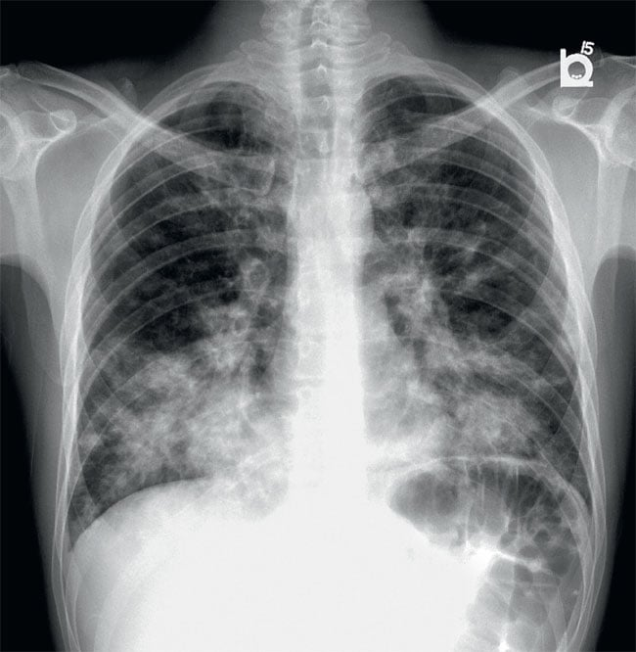
Notes:
A&b; MRI imaging features of HIV-related central nervous system diseases a-f; Contribution of 18F-FDG PET/CT
imaging in the diagnosis x-ray; 45-year-old male patient with HIV | Chest X-Ray interpretation; Ultrasound characterization of superficial lymph nodes in HIV patients with Talaromyces marneffei infection-------------- HIV-associated nephropathy , CT scan. Basal ganglia lacunar infarction in a HIV-positive patient |

Slide 21
Antiretroviral Therapy (ART)
HIV Suppression
1
ART reduces viral load and slows disease progression.
Immune System Restoration
2
ART helps restore and strengthen the immune system.
Improved Quality of Life
3
ART improves overall health and well-being.
Prevention of Transmission
4
ART significantly reduces the risk of HIV transmission.
Notes:
Antiretroviral therapy (ART) is a combination of medications that suppress HIV replication and prevent the virus from damaging the immune system. ART is highly effective in controlling HIV infection and improving the quality of life for people living with HIV.
When taken consistently and correctly, ART can dramatically reduce viral load to undetectable levels, allowing individuals to live long and healthy lives.

Slide 22
Adherence to ART
Regular Medication Intake
1
Taking ART as prescribed.
2
Supportive Care
Access to healthcare, counseling, and social support.
Patient Education
3
Understanding ART benefits, side effects, and importance of adherence.
Monitoring and Evaluation
4
Regular viral load testing and assessment of ART effectiveness.
Adherence to ART is crucial for achieving viral suppression, preventing disease progression, and improving overall health for people living with HIV.
Notes:
It involves taking medications consistently as prescribed, accessing supportive care services, and engaging in ongoing education and monitoring. Effective adherence programs incorporate various strategies to support patients in maintaining their medication regimens and achieving long-term treatment success.

Slide 23
Viral Suppression and HIV Treatment Outcomes
1
Viral Load Reduction
ART effectively reduces viral load to undetectable levels.
2
Improved Immune Function
ART strengthens the immune system, reducing opportunistic infections.
3
Increased Life Expectancy
ART significantly extends the lifespan of people living with HIV.
Improved Quality of Life
4
ART allows individuals to live healthier and more fulfilling lives.
Viral suppression is a crucial goal of HIV treatment.
Antiretroviral therapy (ART) effectively reduces viral load to undetectable levels, which translates into significant improvements in immune function and a reduced risk of transmitting HIV to others.
Notes:
With consistent ART, people living with HIV can live long and healthy lives, free from the debilitating effects of the disease. This not only extends life expectancy but also enhances quality of life, allowing individuals to participate fully in society and achieve their full potential.

Slide 24
Prevention of HIV Transmission
Condom Use
Condoms are highly effective in preventing HIV transmission during sexual activity.
Needle Exchange Programs
Needle exchange programs reduce the risk of HIV transmission
among people who inject drugs.
Antiretroviral Therapy (ART)
ART effectively reduces viral load, minimizing the risk of transmission.
Pre-Exposure Prophylaxis (PrEP)
PrEP is a daily medication taken by HIV-negative individuals to prevent infection.
Post-Exposure Prophylaxis (PEP)
PEP is a short-term course of medication taken after potential exposure to HIV.
Safe Blood Transfusions
Ensuring safe blood transfusions is crucial to prevent HIV transmission through blood products.
Mother-to-Child Transmission Prevention
Preventing mother-to-child transmission involves ART for the mother and safe breastfeeding practices.

Slide 25
Harm Reduction Strategies
1
Needle Exchange Programs
Provide clean needles to reduce the risk of HIV transmission among people who inject drugs.
2
Opioid Substitution Therapy
Methadone and buprenorphine reduce cravings and prevent relapse, reducing risky behaviors.
3
Safe Injection Sites
Supervised consumption facilities provide a safe space for drug use, reducing overdose risk.

Slide 26
Pre-exposure Prophylaxis (PrEP)
Daily Medication
1
Taken by HIV-negative individuals.
Prevention of Infection
2
Reduces risk of acquiring HIV.
Effective When Taken Consistently
3
PrEP is highly effective for prevention.
Pre-exposure prophylaxis (PrEP) is a highly effective HIV prevention strategy that involves taking a daily medication to reduce the risk of acquiring HIV infection.
Notes:
It is recommended for individuals at high risk of HIV exposure, such as those with multiple sexual partners, those in serodiscordant relationships (where one partner is HIV-positive and the other is HIV-negative), and those who inject drugs.

Slide 27
Post-exposure Prophylaxis (PEP)
1
Emergency Intervention
PEP is a short-term course of ART initiated after potential exposure to HIV.
2
High-Risk Exposures
PEP is recommended for individuals who have been exposed to HIV through unprotected sex, needle-stick injuries, or other situations.
3
Effective If Taken Promptly
PEP must be started within 72 hours of exposure to be effective in preventing infection.

Slide 28
Vertical Transmission of HIV
Mother-to-Child Transmission (MTCT)
1
HIV can be transmitted from an infected mother to her child during pregnancy, labor, delivery, or breastfeeding.
Prevention Strategies
2
ART for pregnant women, safe delivery practices, and avoiding breastfeeding reduce MTCT.
Pediatric HIV
3
Infants born with HIV require early ART to prevent disease progression and ensure healthy development.
Vertical transmission of HIV refers to the transmission of the virus from an infected mother to her child during pregnancy, labor, delivery, or breastfeeding.
This is a significant concern, but with effective prevention strategies, the risk of MTCT can be drastically reduced.
Notes:
Prevention measures include antiretroviral therapy (ART) for the mother during pregnancy, safe delivery practices, and avoiding breastfeeding. Infants born with HIV require early and lifelong ART to prevent disease progression and ensure healthy development.

Slide 29
Pediatric HIV/AIDS
HIV in Children
HIV infection in children can have serious consequences for their health and development.
Prevention Strategies
Preventing mother-to-child transmission (MTCT) is crucial to reduce the
number of children living with HIV.
Early Diagnosis and Treatment
Early diagnosis and treatment with antiretroviral therapy (ART) are essential for improving outcomes in children with HIV.
Specialized Care
Children with HIV require specialized care, including monitoring for opportunistic infections and growth and development issues.
Long-Term Management
Long-term management involves lifelong ART, adherence to treatment, and regular monitoring.

Slide 30
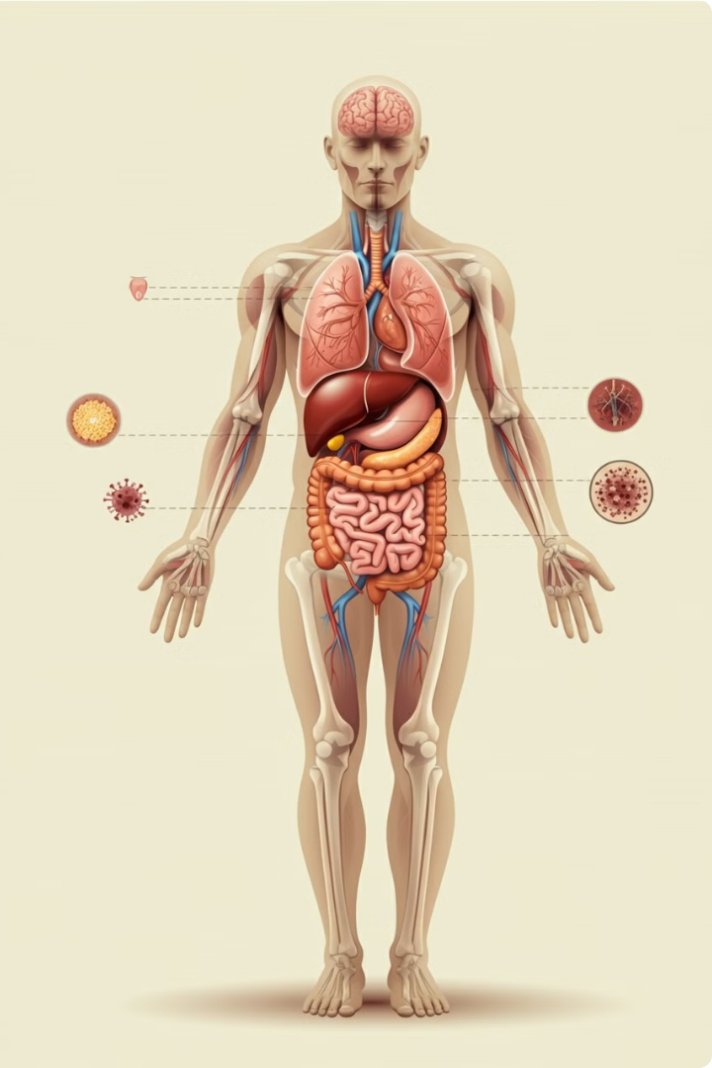
Comorbidities and Coinfections
1
Increased Vulnerability
HIV weakens the immune system, increasing susceptibility to other infections and diseases.
2
Co-occurring Conditions
Individuals with HIV may experience co-occurring conditions like diabetes, heart disease, or mental health issues.
3
Complex Management
Managing comorbidities and coinfections requires a comprehensive approach, including medication, lifestyle changes, and support services.

Slide 31
HIV and Tuberculosis
Increased Susceptibility
1
HIV weakens the immune system, making individuals more vulnerable to tuberculosis.
Co-infection Rates
2
HIV and tuberculosis are often found together, especially in regions with high HIV prevalence.
3
Disease Progression
TB infection can progress more rapidly in people living with HIV.
Treatment Challenges
4
Treating TB in people with HIV is complex, requiring specialized regimens.
TB is a serious opportunistic infection that disproportionately affects people living with HIV. The weakened immune system caused by HIV makes individuals more vulnerable to TB infection.
Notes:
This co-infection poses significant challenges for treatment and management. TB infection can progress more rapidly in people with HIV, leading to severe complications and potentially fatal outcomes.

Slide 32
HIV and Hepatitis
Co-infection Risk
1
HIV weakens the immune system, increasing susceptibility to hepatitis.
Hepatitis B and C
2
Hepatitis B and C are common co-infections among people living with HIV.
Disease Progression
3
Hepatitis can progress more rapidly in people with HIV.
Management Challenges
4
Managing co-infection requires specialized treatment regimens.
HIV and hepatitis are a significant public health concern, particularly in regions with high HIV prevalence.
The weakened immune system caused by HIV makes individuals more vulnerable to hepatitis infections.
Notes:
Hepatitis B and C are common co-infections, leading to liver disease and complications.

Slide 33
HIV and Mental Health
Mental Health Challenges
HIV can lead to anxiety, depression, and other mental health issues due to the chronic nature of the disease, stigma, and treatment side effects.
Stigma and Discrimination
Stigma and discrimination related to HIV can contribute to mental health problems, leading to isolation, social exclusion, and self-stigma.
Impact on Well-being
Mental health issues can impact adherence to HIV treatment, overall health outcomes, and quality of life for people living with HIV.
Support Services
Mental health support services, including counseling and therapy, are crucial for addressing the mental health needs of people living with HIV.

Slide 34
Stigma and Discrimination
Social Exclusion
1
Prejudice and bias can lead to social isolation.
Fear and Misinformation
2
Lack of understanding about HIV fuels stigma.
Discrimination
3
Unfair treatment based on HIV status.
Barriers to Care
4
Stigma can deter people from seeking services.
Notes:
Stigma and discrimination related to HIV can have a profound impact on individuals' lives. Fear, misinformation, and prejudice can lead to social exclusion, discrimination, and barriers to accessing healthcare services.

Slide 35
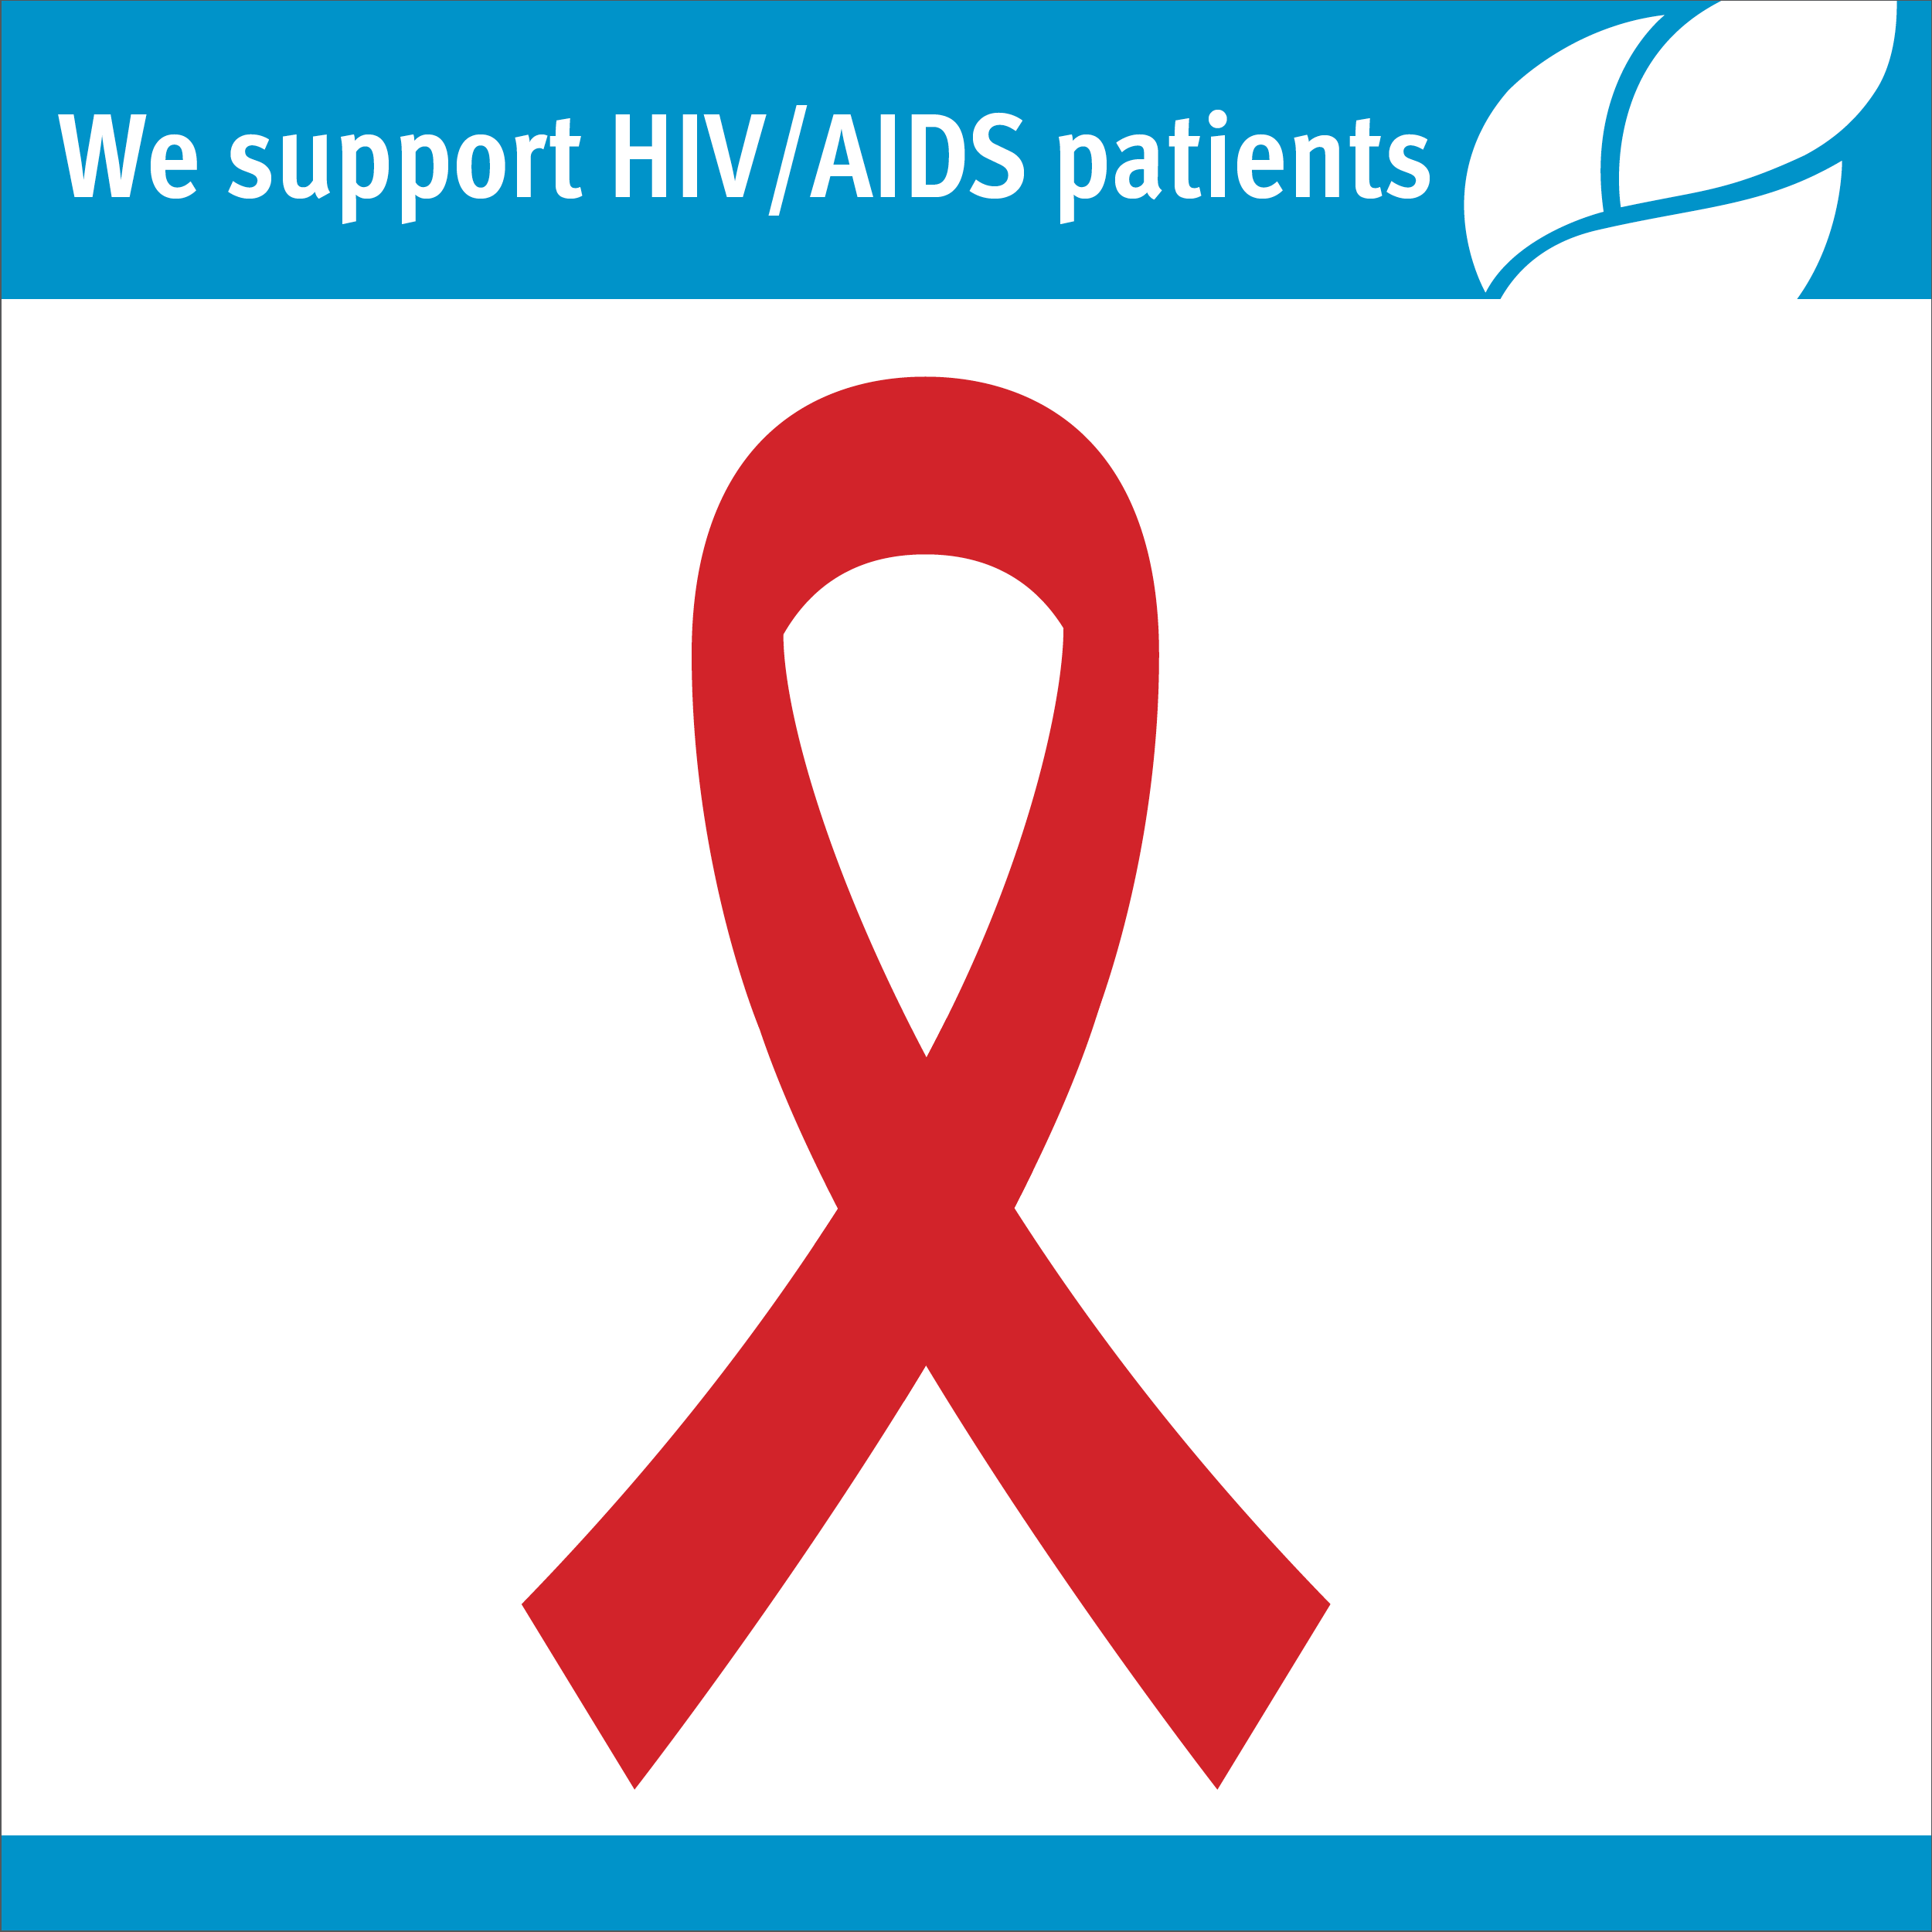
Access to HIV Services
Availability
1
Ensuring adequate access to services.
Accessibility
2
Reaching vulnerable and marginalized populations.
Affordability
3
Cost-effective and subsidized services.
Acceptability
4
Culturally sensitive and non-stigmatizing services.
Notes:
Accessibility to HIV services is crucial for effective prevention, diagnosis, and treatment. Adequate availability, affordability, and acceptability of services are essential to reach individuals in need, particularly those from marginalized communities.

Slide 36
Health Systems and HIV Care
Integrated Care
HIV care should be integrated into primary healthcare systems,
ensuring seamless access to services.
Strong Infrastructure
Robust healthcare systems are essential for providing quality HIV care, including laboratory services, ART provision, and counseling.
Human Resources
Sufficiently trained healthcare professionals, including doctors, nurses, and counselors, are needed to provide comprehensive HIV care.
Financial Sustainability
Sustained funding and resource allocation are crucial for strengthening HIV programs and ensuring long-term care.
Data and Monitoring
Data collection and monitoring systems are vital for tracking
progress and identifying areas for improvement.

Slide 37
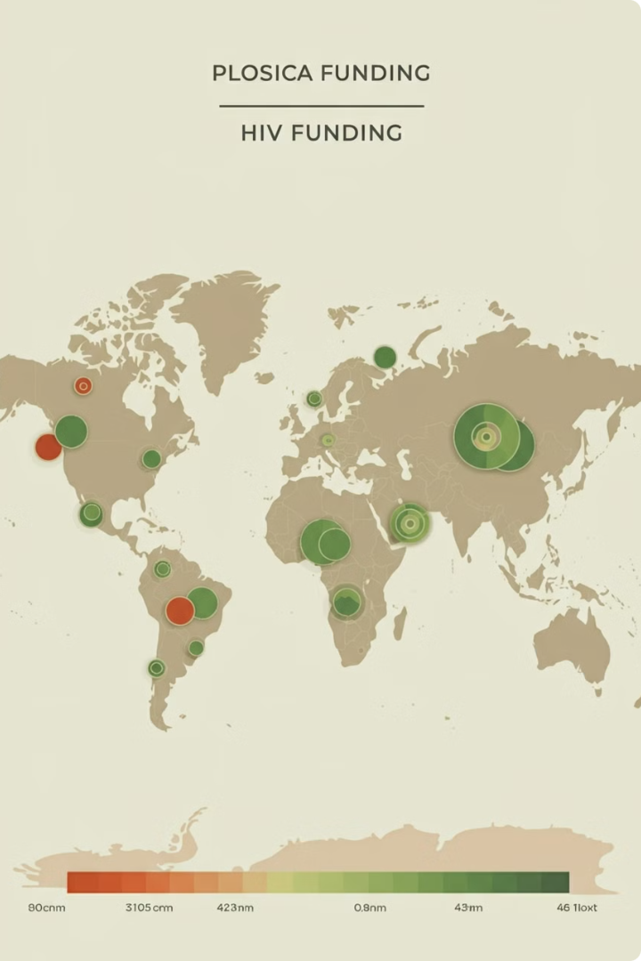
Funding and Financing for HIV/AIDS
1
Global Funding Landscape
International organizations like the Global Fund and PEPFAR provide crucial funding for HIV programs in low- and middle-income countries.
2
Domestic Funding
Governments around the world allocate funds for national HIV programs, including prevention, treatment, and care services.
3
Private Sector Investment
The private sector plays a growing role in HIV funding, supporting research, development, and innovative approaches to care.

Slide 38
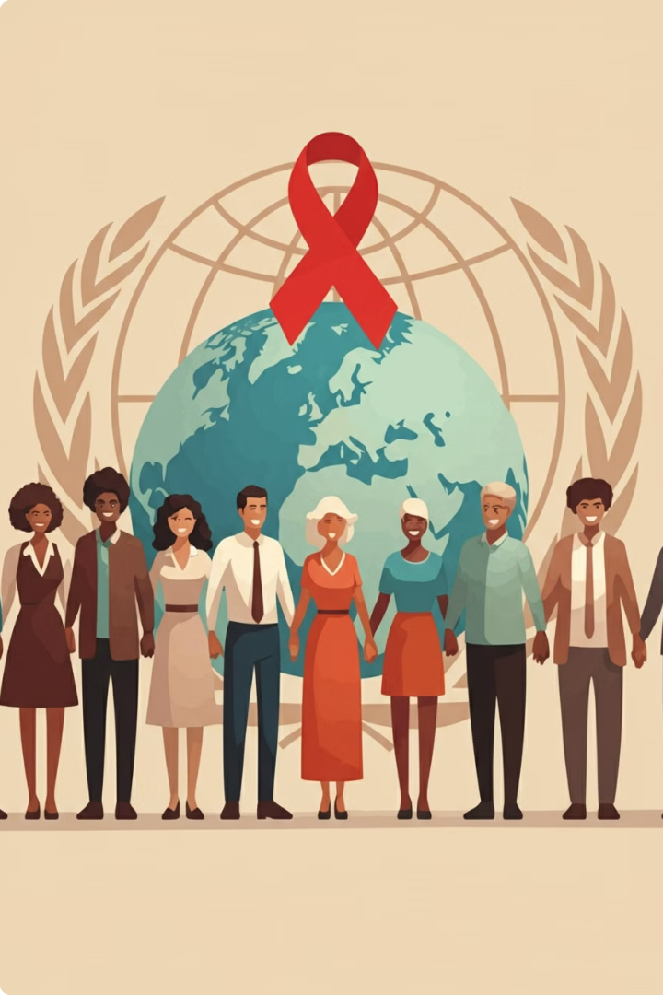
Global Initiatives and Partnerships
1
Global Fund to Fight AIDS, Tuberculosis and Malaria
The Global Fund is a partnership that finances programs in low- and middle-income countries, supporting HIV prevention, treatment, care, and support services.
2
President's Emergency Plan for AIDS Relief (PEPFAR)
PEPFAR is a US government initiative providing funding and technical assistance to countries with high HIV burdens, focusing on prevention, treatment, and care.
3
Joint United Nations Programme on HIV/AIDS (UNAIDS)
UNAIDS leads and coordinates the global HIV response, advocating for policies, mobilizing resources, and promoting access to HIV services.

Slide 39
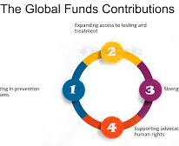
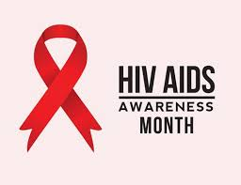
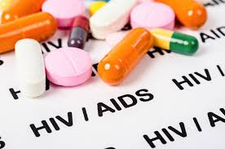
Challenges and barriers in the HIV response
1
Financial Constraints
Limited resources hinder program effectiveness.
2
Stigma and Discrimination
Prejudice and bias impede access to services.
3
Lack of Awareness
Insufficient knowledge about HIV transmission and prevention.
Treatment Access
4
Unequal distribution of resources limits access to medication.
Addressing the HIV epidemic faces numerous challenges. Financial constraints limit the scale and effectiveness of programs.
Stigma and discrimination create barriers to care, deterring people from seeking services.
Notes:
Lack of awareness about HIV transmission and prevention methods hinders efforts to reduce new infections. Treatment access is also a major barrier, particularly in resource-limited settings.

Slide 40
Future Directions and Research Priorities
Novel Therapies
1
Develop new drugs and treatments for HIV.
2
Prevention Strategies
Improve existing prevention methods and explore new ones.
3
Cure Research
Investigate potential cures for HIV infection.
4
Long-Term Management
Develop strategies for managing HIV in the long term.
5
Social and Behavioral Factors
Address the impact of stigma and discrimination.
Notes:
The future of the HIV response depends on continued research and innovation. Key areas of focus include developing novel therapies to improve treatment outcomes, exploring new prevention strategies, and conducting research on potential cures for HIV. Addressing the impact of social and behavioral factors is also crucial for reducing stigma and discrimination.

Slide 41
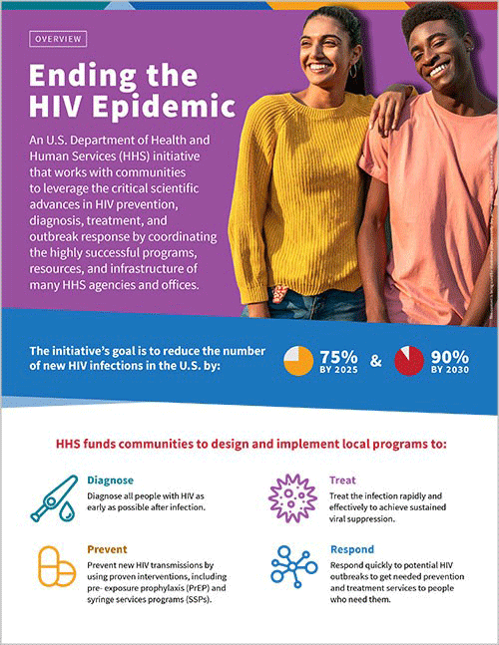
Key Takeaways
The global response to HIV/AIDS has made significant progress, but challenges remain. Continued efforts are needed to achieve universal access to prevention, treatment, and care services.
Addressing stigma, discrimination, and financial constraints is crucial for ensuring an equitable and effective response.
Research and innovation are essential for developing novel therapies, improving prevention strategies, and exploring potential cures for HIV.

